Slide 1
Recurrent Neural Network(RNN)
Type of Neural Network where the output from previous step are fed as input to the current step. In traditional neural networks, all the inputs and outputs are independent of each other, but in cases like when it is required to predict the next word of a sentence, the previous words are required and hence there is a need to remember the previous words. Thus RNN came into existence, which solved this issue with the help of a Hidden Layer. The main and most important feature of RNN is Hidden state, which remembers some information about a sequence.

Slide 2
Recurrent Neural Networks (RNNs) are a type of neural network architecture particularly suited for sequential data processing. They are widely used in deep learning for tasks such as natural language processing (NLP), speech recognition, time series analysis, and more. The key characteristic of RNNs is their ability to maintain a hidden state that captures information about previous inputs in the sequence, allowing them to effectively model dependencies in sequential data.

Slide 3
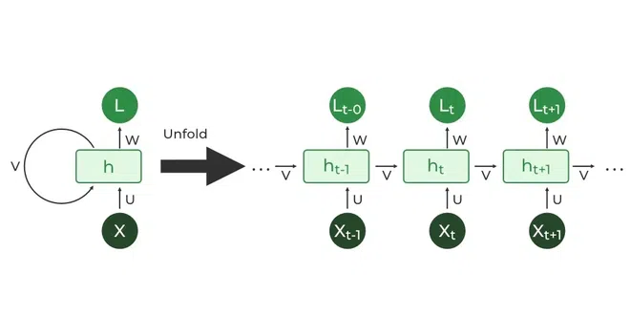

Slide 4
Why RNN is required????
RNN works very well in sequence of data as input.
So it is used in Spam Classifier,Time series,weather forecasting

Slide 5
yi
f
Ot
X1t

Slide 6
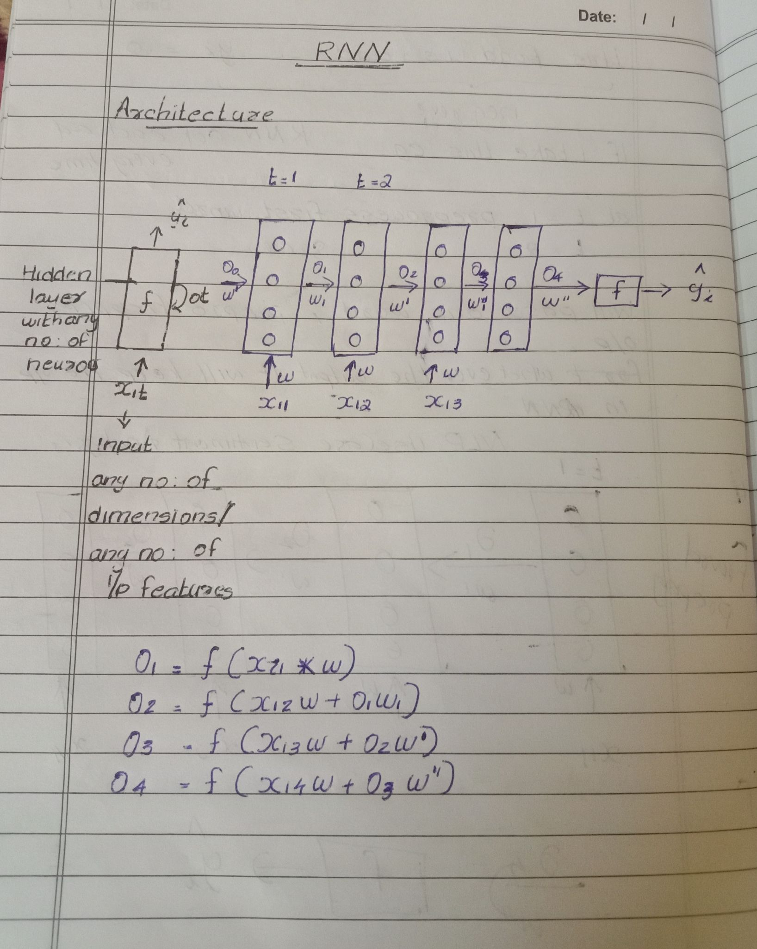

Slide 7
Natual Language Processing(NLP use case) ------sentimental analysis
X1 = <X11 , X12 ,X13,X14> yi
X1 --- sentence
X11 , X12 ,X13,X14 - ------- No of words in that sentence
The food is bad----negative review

Slide 8
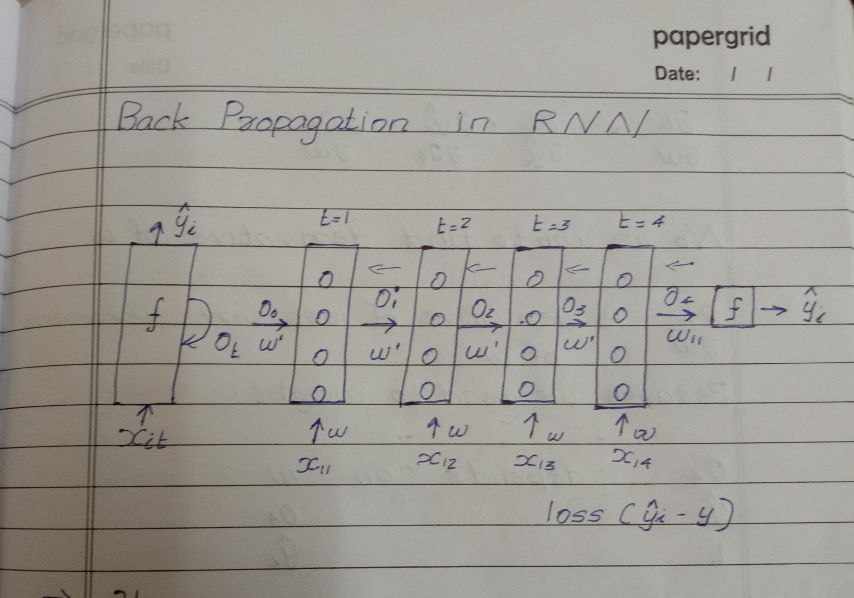

Slide 9
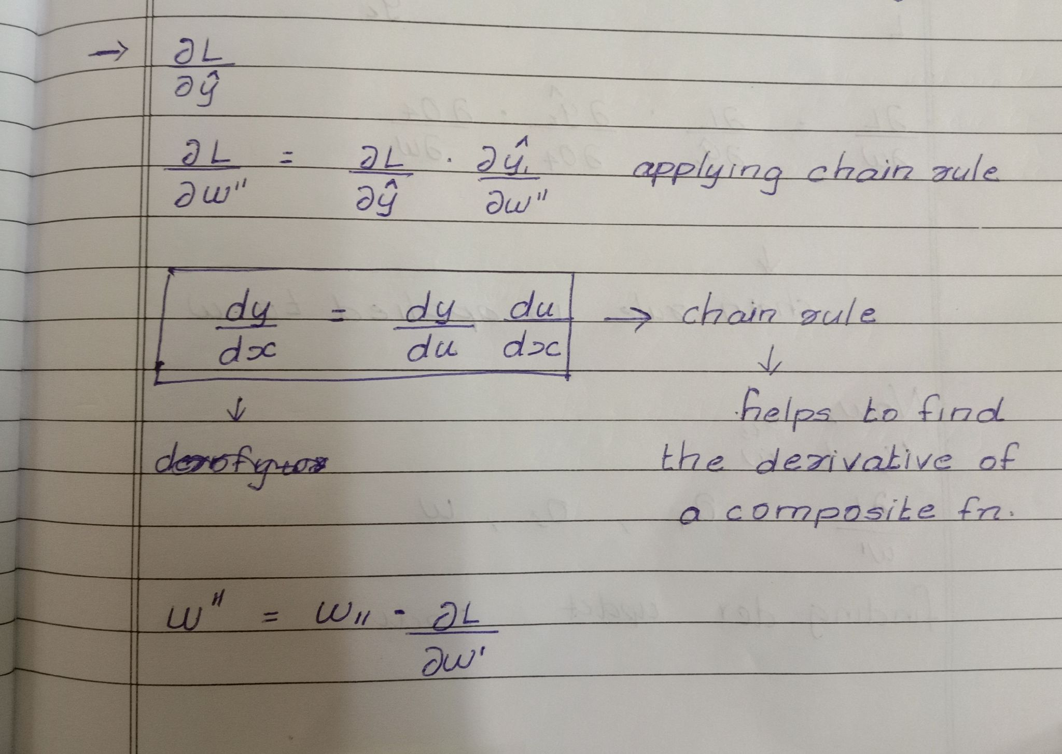

Slide 10
